Slide 1


LIZZYUNIQUEWRLD
PORTFORLIO PRESENTATION

Slide 2
CONTENT
MISSON / VISION
CORE VALUE / PROMISE TO CUSTOMERS
ABOUT LIZZYUNIQUEWRLD
OUR TARGET MARKET
SALES AND MARKETING STRATEGY
PRODUCT CATALOG

Slide 3
MISSION / VISION
MISSION
Our mission is to be the most centric company where customers can get the best quality/ lifestyle products.
VISSION
Our vision is to have a massive fashion line/school that will provide unique handbags services to general public both national and international.

Slide 4
CORE VALUE/ PROMISE TO CUSTOMERS
CORE VALUE
Hard work Excellence
Integrity Collaboration
Innovation Customers satisfaction
PROMISE TO CUSTOMERS
Efficiency Satisfactory
Open and honest Customer focused
Ethical

Slide 5
ABOUT LIZZYUNIQUEWRLD
Lizzyuniquewrld is an independent handbag shop proud to be your favorite handbag crafted with love and which are of good quality. We are here to serve you with better, elegant, quality and fabulous designs of your choice. Great service guaranteed.

Slide 6
OUR TARGET MARKET
Lizzyuniquewrld plan to target males and females . Note that within this group, there are no colour barriers.

Slide 7
SALES AND MARKETING STRATEGY
SOURCE OF INCOME
Lizzyuniquewrld make profit from providing our clients with assorted handbags and many other services like hair bands, etc.
Our marketing strategy are online which are Instagram, Facebook and Google. With time we term to go for an advanced advert.

Slide 8
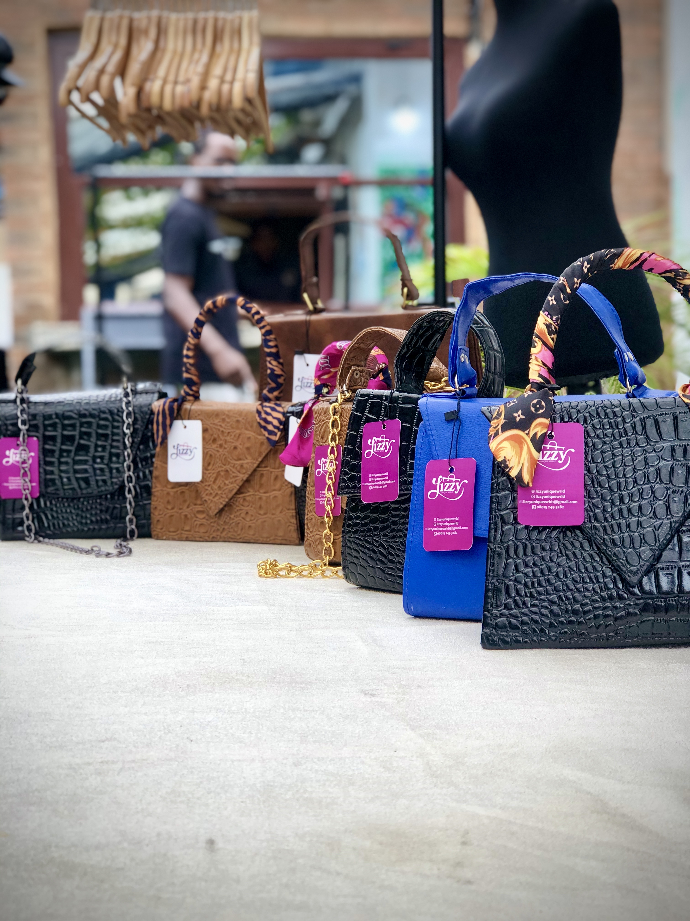
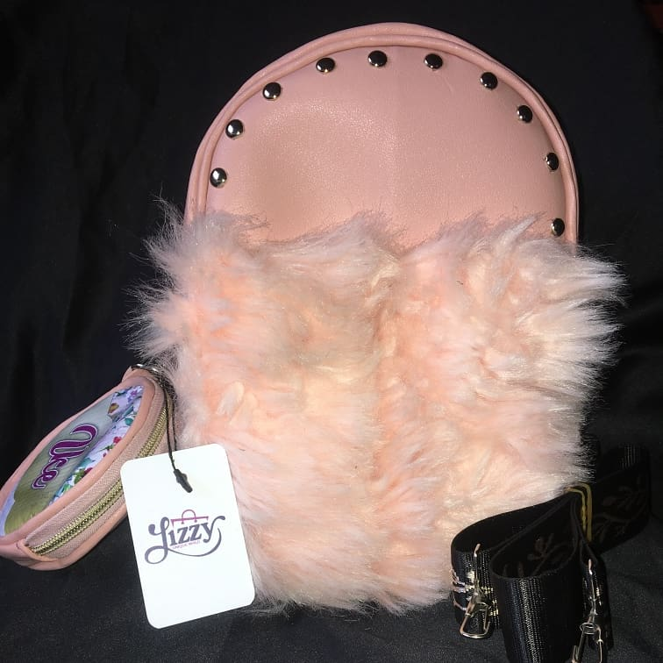
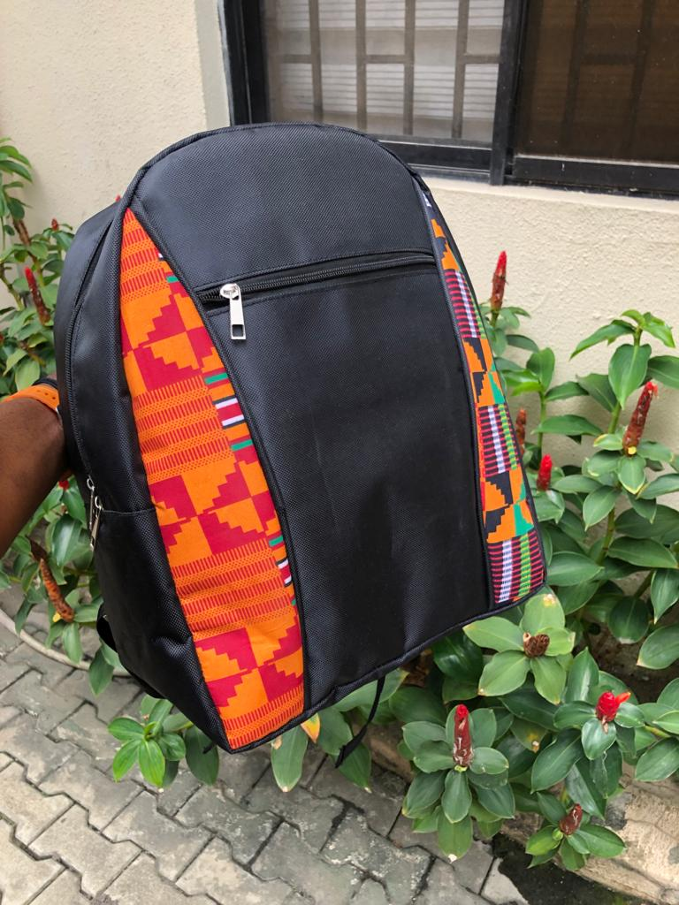
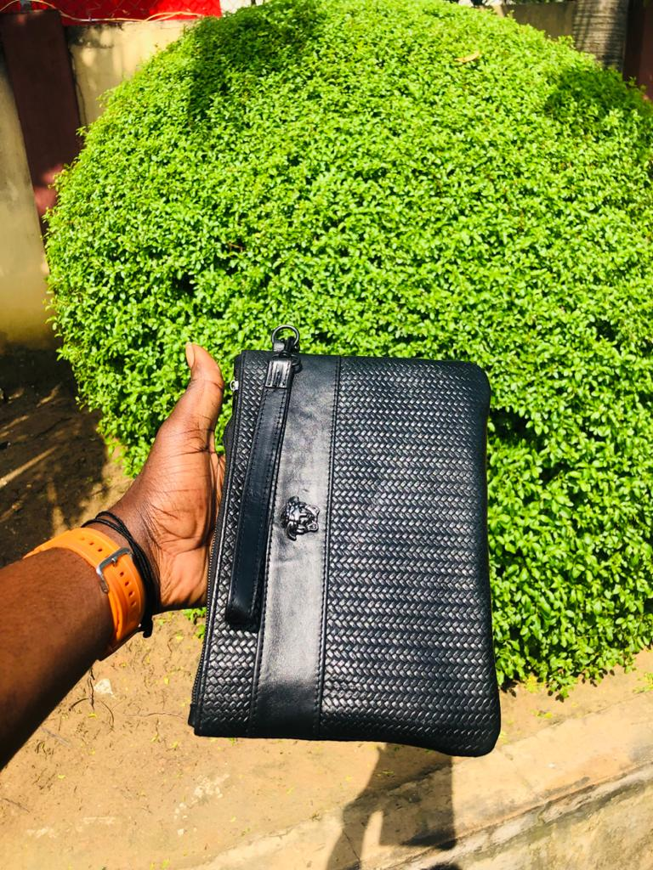
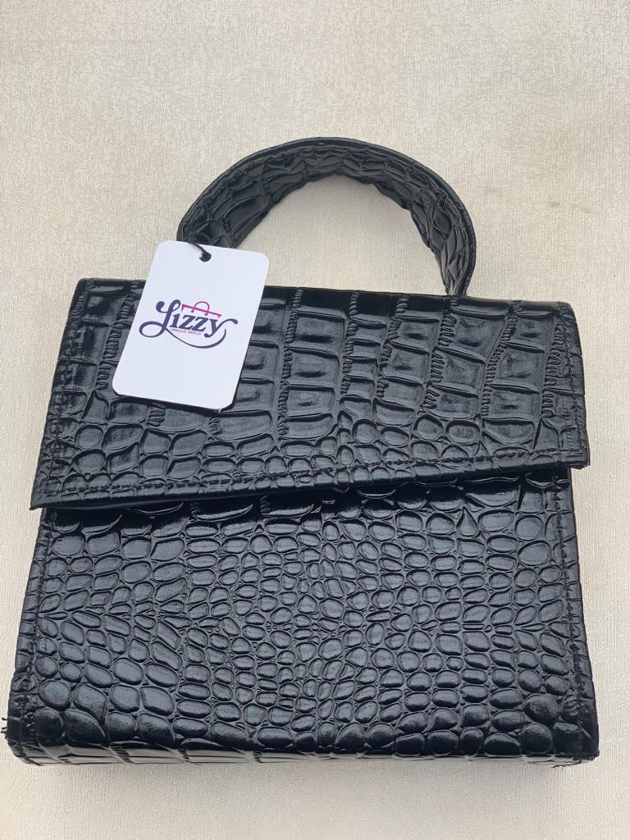
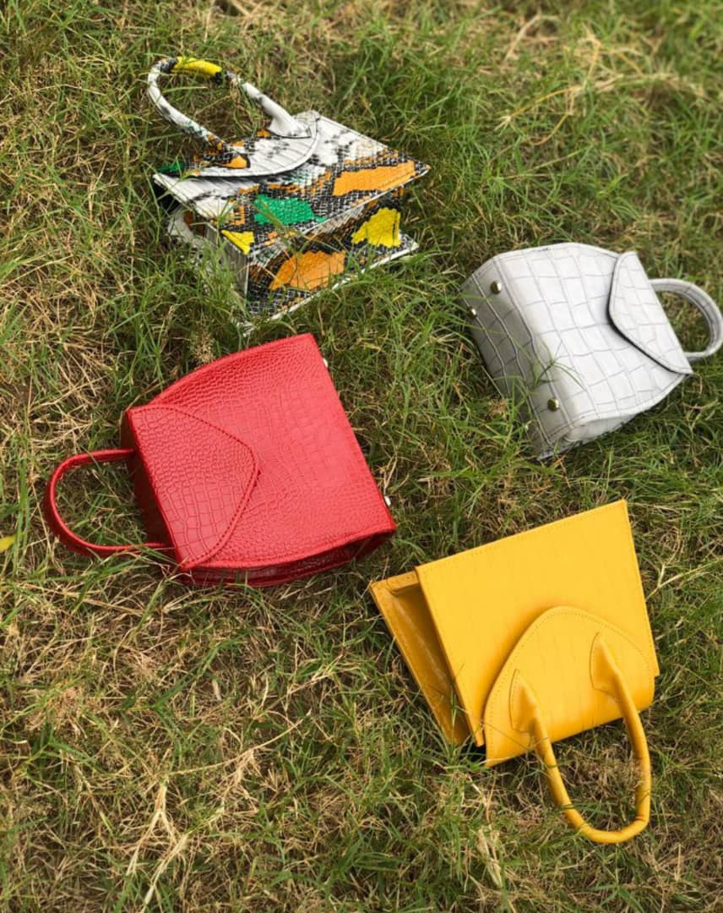
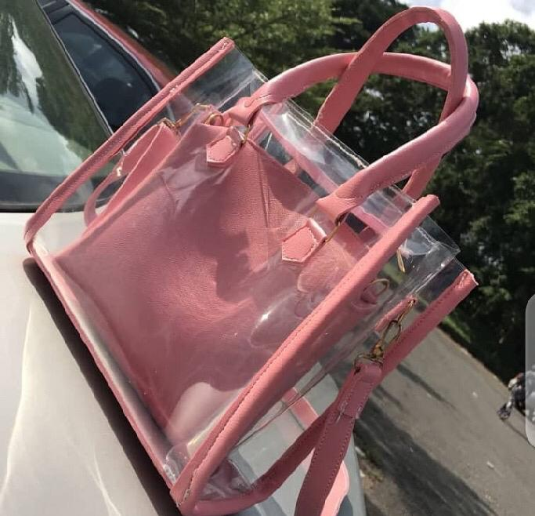
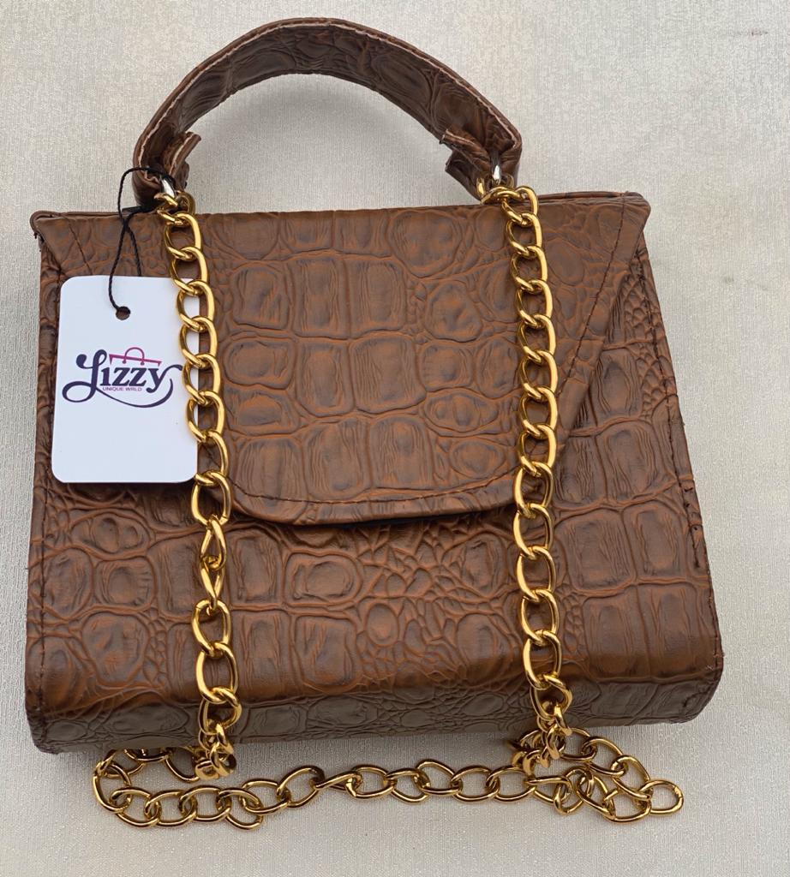
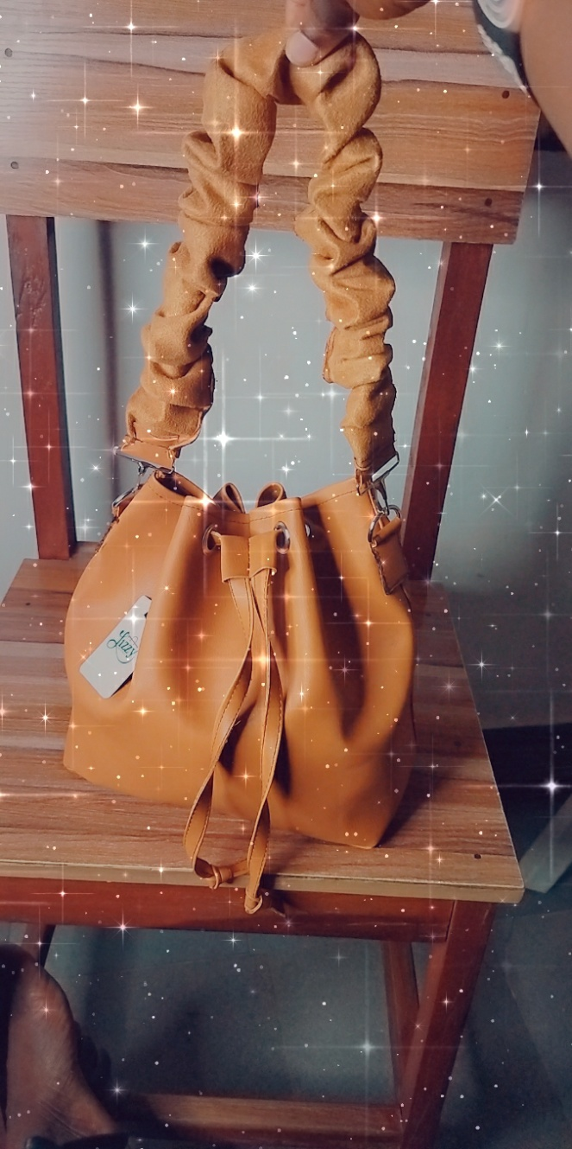
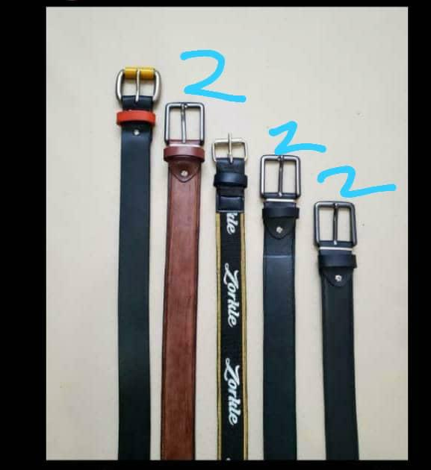
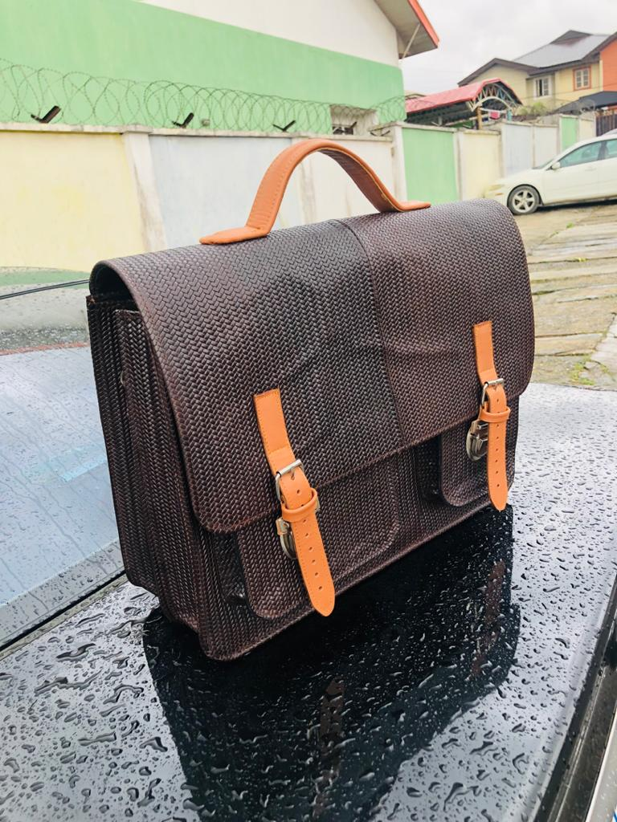
PRODUCT CATALOG

